Slide 1
Lecture 1
C Quick Review
CSC2302
H.Talei

Slide 2
Main Points
C Main Data Types
C Selection Statements
C Loop Statements
Function / Parameters
Arrays
String
CSC2302
H.Talei

Slide 3
C Main Data Types
There are three basic data types:
  int
    Entire numbers (integers), between -32767 and 32767
  double
    Real numbers (1.2344) (3.456e+3 - Scientific Notation)
  char
    Used to declare characters. A variable of type char can contain only one character of the following types:
      Alphabetic: (a,b,c, …., z, A, B, C, …., Z)
      Numeric: (0,1,2, …., 9)
      Special characters: (+, -, =, %, ?, !, ;, / …..)
      Spaces
CSC2302
H.Talei

Slide 4
Control Structures
Program Control => Order of Execution
3 Control structures: sequential, selection, repetition
  Sequential: default order
    Function executes in order from top to bottom
  Selection (conditional):
    One way selection: if statement
    Two-way selection: if else statement
    N-way selection:
      Cascading if else (if … else if … else if … else …)
      Switch statement: requires an expression whose value is of an enumerable type
CSC2302
H.Talei

Slide 5
Control Structures ( Cont..)
  Repetition (loops):
    Definite iteration: for statement
    Indefinite iteration:
      while statement
      do ... while statement
CSC2302
H.Talei

Slide 6
Functions
  Avoid repetition of code
    Avoid repetition of errors
  Reuse
    By yourself
    By others (in libraries)
  Clearer program organization
    Breaks down tasks
  Parameterized code
    Functions usually have parameters
CSC2302
H.Talei

Slide 7
Local Variables vs Passing by value vs Passing by reference??
CSC2302
H.Talei

Slide 8
Arrays
Why Arrays?
   There is a need to gather data of the same type!
What is an Array?
   An Array is a sequence of data items, of the same type, that are, i.e ‘The Items’:
    Indexible
    Stored Contiguously (in Memory – the RAM,)
Array is a ‘Data Structure’ that is used to represent a large number of Homogenous Values
Elements of an Array are accessed using indexes
CSC2302
H.Talei

Slide 9
Arrays(Cont..)
  Base element type: the element contained in each cell
    E.g. char CharArray []; int IntegerArray [5][10]
  Dimensions:
    Unidimensional (1-D)
    Multidimensional (2-D, 3-D, 4-D, n-D)
  Bounds:
    subscripts range from 0 to size-1 in each dimension.
CSC2302
H.Talei

Slide 10
Strings
A string is a one-Dimensional array of type char.
The End-of-String Sentinel ‘\0’:
  A constant string such as ‘’abc’’ is stored in memory as four characters. The last one is ‘\0’, called also the Null Character.
  Thus the length of the string ‘abc’ is 3. But the size of the string is 4.
To declare a string you do:
  char word[MAXWORD];
To read a string (%s):
  scanf(``%s``, word); //& is omitted. Why?
  If user types test, we will have:
    Word[0] = ‘t’; word[1] = ‘e’; word[2]=‘s’; word[t]=‘o’;word[4]=‘\o’;
  scanf stops when a space OR a ‘\n’ is encountered.
CSC2302
H.Talei

Slide 11
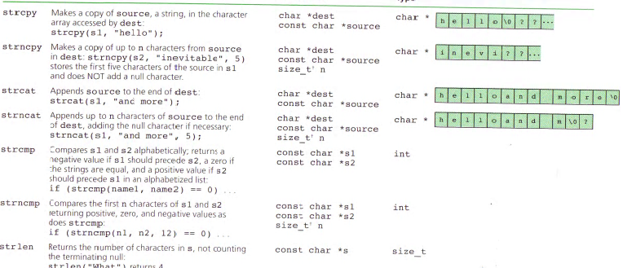
Strings( Cont..)
CSC2302
H.Talei

Slide 12
Exercise
I posted a code in the portal used to manage students grades.
Please review the code and make sure that you understand it very well.
Please refer to me for a non-clear piece of code
CSC2302
H.Talei

